Slide 1
Going After Cacciatio: Playing With and Against Notions of War
A Former IB Student IB English
Mr. Rhinehart

Slide 2
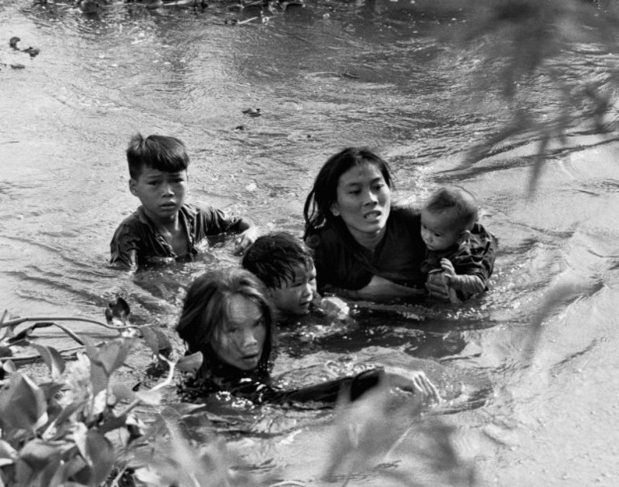
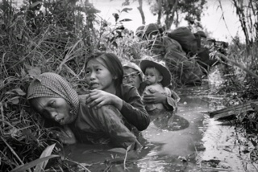
Preconceived Notions of Vietnam War
Shell Shock/ PTSD
Hell on earth
Death after death

Slide 3
“It was a bad time. Billy Boy Watkins was dead, and so was Frenchie Tucker. Billy Boy had died of fright, scared to death on the field of battle, and Frenchie Tucker had been shot through the nose.” –Going After Cacciato, Pg 1

Slide 4
“The Lieutenant kept rocking. He did not look well. When the flame was gone, he pushed himself to his feet, coughed, spat, and touched his toes. ‘All right,’ he sighed. ‘Third Squad goes after Cacciato.” –Going After Cacciato, Pg. 7

Slide 5
“The truths are contradictory. It can be argued, for instance, that war is grotesque. But in truth, war is beauty. For all its horror, you can’t help but gape at the awful majesty of combat... It’s not pretty, exactly. It’s astonishing.” – How to Tell a True War Story, Pg 7

Slide 6
Conclusion:
How does this contradiction of the story affect the Verisimilitude?

